Slide 1

SOC DaML Mini-Project
Luca Specht

Slide 2
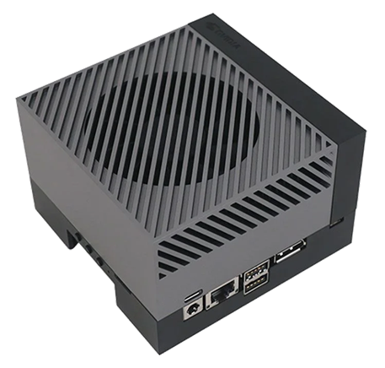
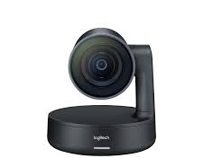
Task
Control a FIZ Camera using the GPIOs of a Nvidia Jetson
Focus
Iris
Zoom

Slide 3
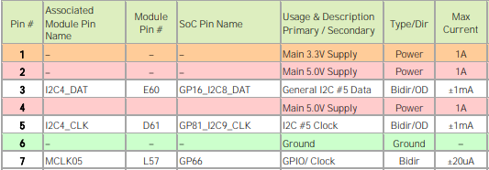

Challenge
Jetson GPIOs are 3.3V and low current (>1mA)
FIZ camera requires at least 5V and 20mA or 40mA respectively
→ use GPIOs to control level shifter which is driven by the 5V main supply

Slide 4
Level Shifter
V_{ref}
V_{in}
V_{out}
V_{in} | V_{out}
0 V | 0 V
3.3 V | 5 V
GND

Slide 5

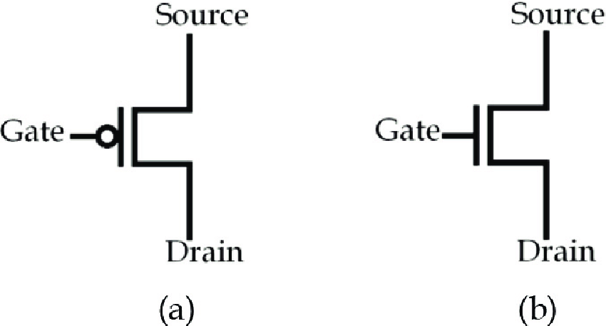

Schema
V_{ref}
V_{ref}
V_{out}
V_{in}

Slide 6
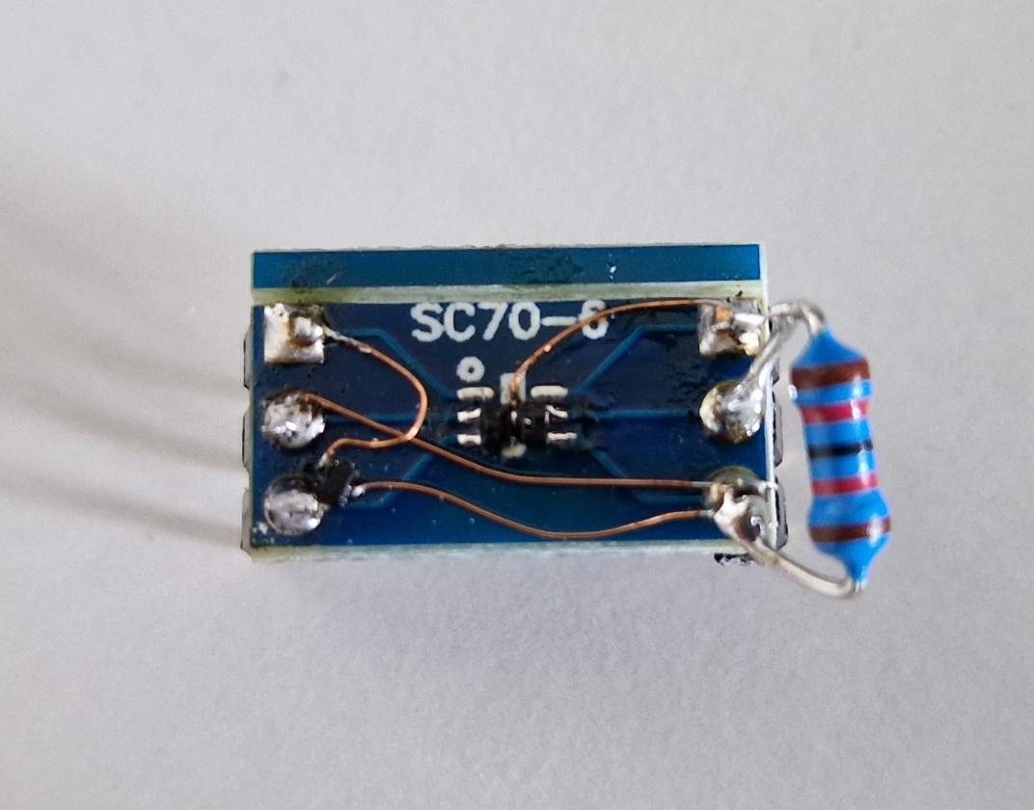
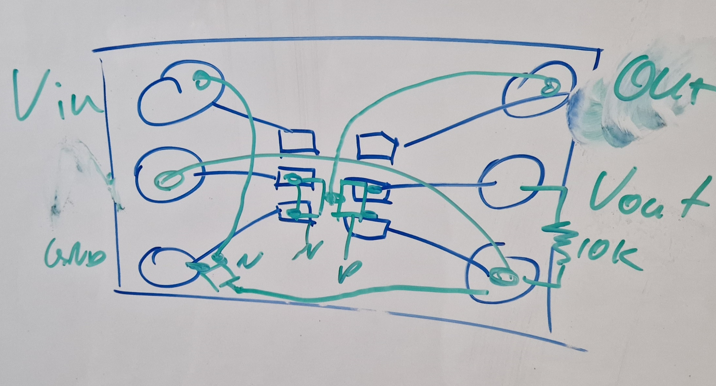
Layout
V_{out}
V_{in}
V_{ref}
GND
N
N
P

Slide 7
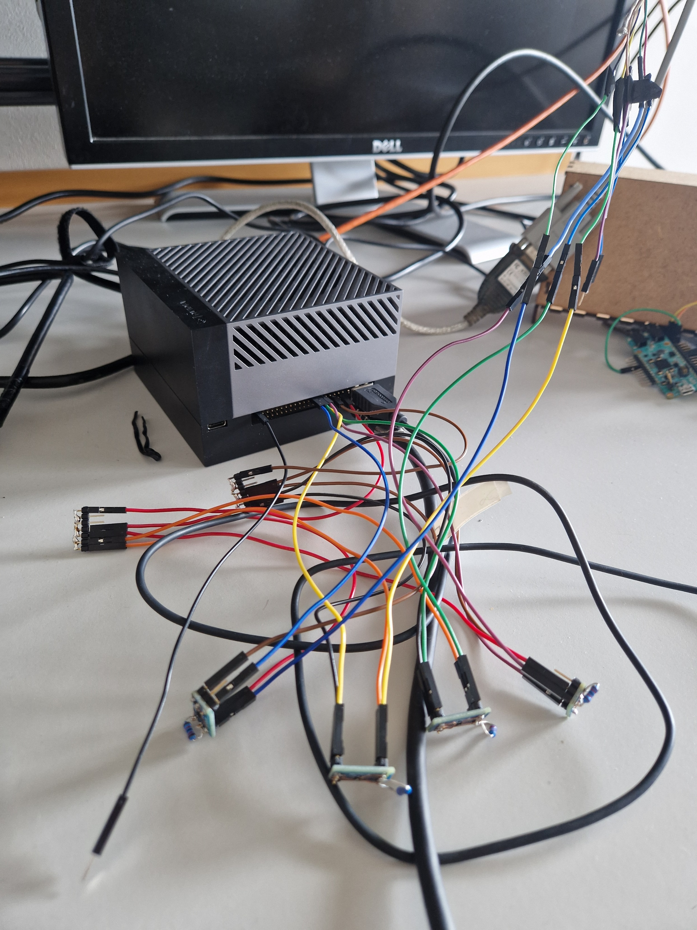
Final Setup
Camera
Jetson
Inputs
Outputs
GND
5V
Level Shifters

Slide 8
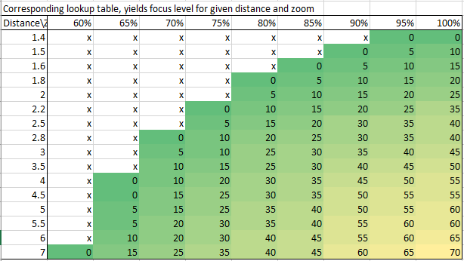
Focus, Iris and Zoom
Given the distance between object and camera → determine the best configuration of focus, iris and zoom
Empirical approach → create look-up table

